Slide 1
Autonomous Aerial Vehicle
Midterm Presentation I
Team Six
Greg Buker
Steven Cutchins
Jennifer Gavin
Stephen Kwon
Ernandes Nascimento
Mark Parish
Jason Randall
Bernardo Raposo
Project Advisors: Dr. Chiang Shih, Dr. Michael Frank, Dr. Kamal Amin, Dr. Farrukh Alvi

Slide 2
Discussion Topics
Background and Competition Requirements
Decision Matrix
Choice of Vehicle
Camera Choice and Implementation
Autopilot System
Air Drop System
Rejected Options
Future Plans

Slide 3
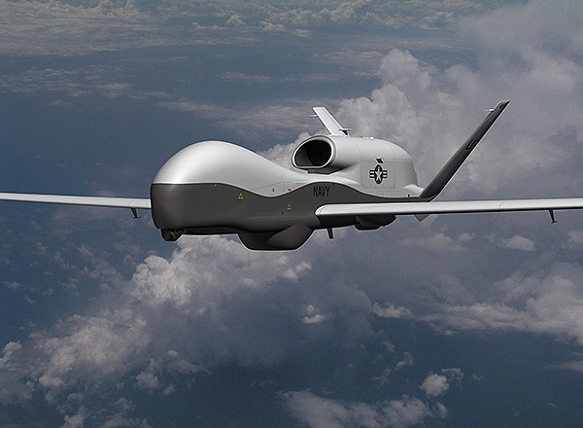
UAS (Unmanned Aerial System) Background
UAS’s have been around since as early as 1849 – (Austria attached explosives to controlled balloons)
Modern UAS’s became effective in 1987 with electronic decoys, electronic jammers, and real time video reconnaissance
As of 2010, 41% of the total DoD aircraft are unmanned Based on estimates by the Teal Group, $6.6 billion will be spent in 2013 worldwide on Unmanned Aerial Systems ¹
Northrop Grumman Triton UAV can fly for 24 hours or up to 11,500 nautical miles without refueling ²
Notes:
MARK

Slide 4
Competition Requirements
Competition requirements broken up into 2 categories: Primary and Secondary Primary Tasks are weighted 60%; Secondary,40% ³
Primary Tasks: Autonomous Flight Area Search | Basic Requirements:
Secondary Tasks: Automatic Target Detection Actionable Intelligence Off-Axis Target Locating Emergent Target Detection Simulated Remote Information Center Interoperability Task Infrared Target Locating Air Drop System | Vehicle must fly between 100ft and 750ft MSL Max mission time of 40 minutes, bonus points for completion between 20 and 30 minutes System must display real-time speed and altitude System must display no-fly zone System must be able to capture images System must be able to fly to given waypoints
Notes:
MARK

Slide 5
Competition Requirements
Competition requirements broken up into 2 categories: Primary and Secondary Primary Tasks are weighted 60%; Secondary,40% ³
Primary Tasks: Autonomous Flight Area Search | Basic Requirements:
Secondary Tasks: Automatic Target Detection Actionable Intelligence Off-Axis Target Locating Emergent Target Detection Simulated Remote Information Center Interoperability Task Infrared Target Locating Air Drop System | Vehicle must fly between 100ft and 750ft MSL Max mission time of 40 minutes, bonus points for completion between 20 and 30 minutes System must display real-time speed and altitude System must display no-fly zone System must be able to capture images System must be able to fly to given waypoints
Notes:
MARK

Slide 6
Competition Requirements
Competition requirements broken up into 2 categories: Primary and Secondary Primary Tasks are weighted 60%; Secondary,40% ³
Primary Tasks: Autonomous Flight Area Search | Basic Requirements:
Secondary Tasks: Automatic Target Detection Actionable Intelligence Off-Axis Target Locating Emergent Target Detection Simulated Remote Information Center Interoperability Task Infrared Target Locating Air Drop System | Vehicle must fly between 100ft and 750ft MSL Max mission time of 40 minutes, bonus points for completion between 20 and 30 minutes System must display real-time speed and altitude System must display no-fly zone System must be able to capture images System must be able to fly to given waypoints
Notes:
MARK

Slide 7
Decision Matrix
Objective | Competition Priorities | Cost | Difficulty | Required Time | Risk | Totals
Autonomous Flight | 10 | 10 | 8 | 9 | 5 | 42
Buy New Plane | 6 | 4 | 9 | 9 | 10 | 38
Modify Old Plane | 4 | 8 | 6 | 6 | 4 | 28
Retractable Landing Gear | 2 | 6 | 6 | 5 | 6 | 25
Glass Camera Door | 3 | 9 | 8 | 9 | 9 | 38
Retractable Camera Door/Gimbal System | 9 | 5 | 5 | 3 | 6 | 28
Infrared Camera | 7 | 0 | 5 | 7 | 0 | 19
Modular Design | 3 | 7 | 4 | 4 | 5 | 23
Autonomous Takeoff/Landing | 7 | 9 | 5 | 6 | 3 | 30
Autopilot System Training | 2 | 7 | 3 | 3 | 8 | 23
Autonomous Target Recognition | 7 | 9 | 3 | 3 | 8 | 30
Air Drop System | 7 | 6 | 6 | 7 | 8 | 34

Slide 8
Decision Matrix
Objective | Competition Priorities | Cost | Difficulty | Required Time | Risk | Totals
Autonomous Flight | 10 | 10 | 8 | 9 | 5 | 42
Buy New Plane | 6 | 4 | 9 | 9 | 10 | 38
Modify Old Plane | 4 | 8 | 6 | 6 | 4 | 28
Retractable Landing Gear | 2 | 6 | 6 | 5 | 6 | 25
Glass Camera Door | 3 | 9 | 8 | 9 | 9 | 38
Retractable Camera Door/Gimbal System | 9 | 5 | 5 | 3 | 6 | 28
Infrared Camera | 7 | 0 | 5 | 7 | 0 | 19
Modular Design | 3 | 7 | 4 | 4 | 5 | 23
Autonomous Takeoff/Landing | 7 | 9 | 5 | 6 | 3 | 30
Autopilot System Training | 2 | 7 | 3 | 3 | 8 | 23
Autonomous Target Recognition | 7 | 9 | 3 | 3 | 8 | 30
Air Drop System | 7 | 6 | 6 | 7 | 8 | 34

Slide 9
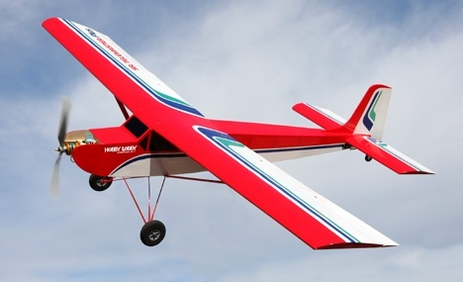
Decision to Purchase a New Plane
Flaps will be pivotal in autonomous takeoff/landing
Increased lift allows for faster, more stable takeoff and lower stall speed for safe landing
Electric motor will allow for increased image quality
Vibration from gas powered motor caused distortion in images captured by previous design team
Fuselage will not require repairs before modification and implementation of new equipment
Previous design group’s plane will used for low risk flight practice and equipment testing

Slide 10
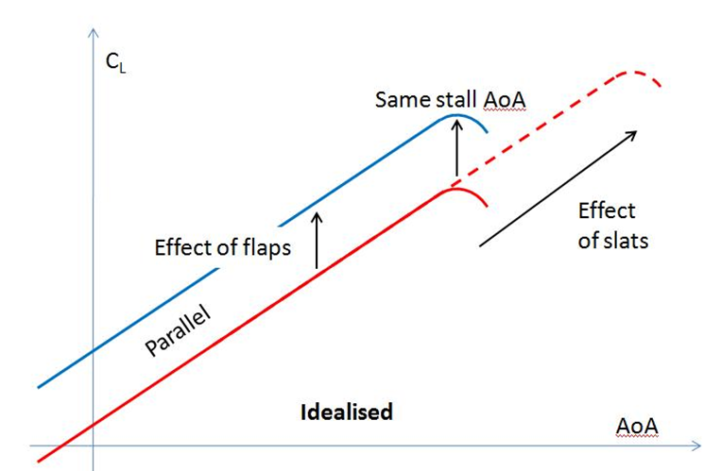
Lift Coefficients
Airfoil on Sr. Telemaster Plus is very similar to the Anderson SPICA airfoil
Coefficient of lift can be assumed to be the same, and can be seen to the right⁴
Flaps move the C_{l} curve up at every angle of attack (increasing lift), but do not increase the stall angle, as seen to the left⁵
Sr. Telemaster Plus at 10° AoA: Stall speed decreases from 19.79 mi/hr to 16.16 mi/hr with flaps
Idealized

Slide 11
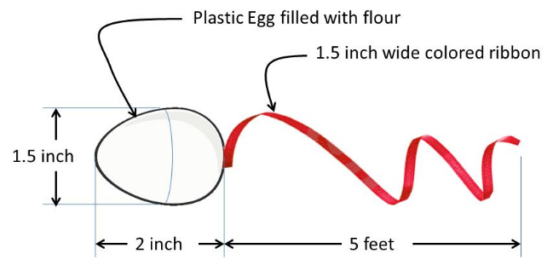
Air Drop System
This task will simulate supply drop or fire retardant release
Competition goal: drop egg filled with flour when a target is recognized
Egg must fall within target boundary
Take cruising speed, drop height into account
Mechanism may be autonomous or manual
Autonomous Air Drop will be given bonus points

Slide 12
Air Drop System – Design and Simulation
Two-door approach
Minimize air resistance when doors are open
Minimize additional horizontal velocity components from release
Cut doors from existing plane body
Basic four-bar linkage to open/close doors
Controlled by two servo motors
Egg cup: cut from foam
Provides cushioning
Will compress, allowing doors to fully open

Slide 13
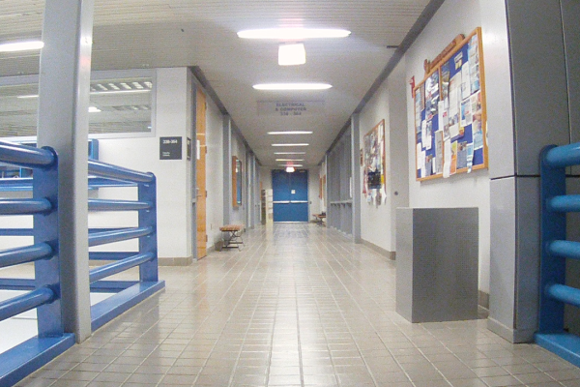
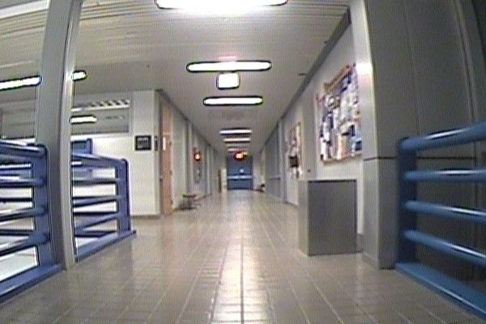
Choice of camera (GoPro vs SD Camera)
Sample target size (blue doors): 6ft x 8 ft Target distance: 100ft
Higher resolution makes identifying details (alphanumeric on target) easier
Increased resolution means increased bandwidth but digital signal is less susceptible to noise
GoPro
Old Camera
Notes:
Min target size: 2 ft x 2 ft
Max target size: 8 ft x 8 ft
Min target distance: 100 ft
Max target distance: 750 ft

Slide 14
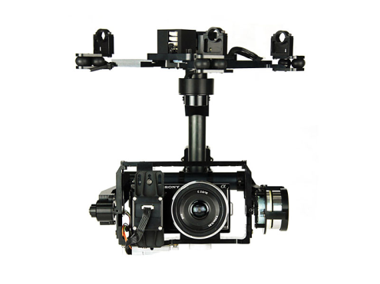
Choice of Camera Implementation
Gimbal system: self-leveling camera mounted externally
Positive: allows level camera angle while plane pitches, rolls, or yaws
Negative: expensive, difficult to implement
Glass door approach: stationary camera inside fuselage
Positive: low cost, does not disrupt air flow, easy to implement
Negative: plane must stay level during flight to gather useful images
The glass door approach will be tested as soon as possible to determine validity. If problems are encountered, the gimbal system will be utilized.

Slide 15
Compare Videos (Gimbal vs Fixed)
Gimbal-mounted camera
Fix-mounted camera
Significant difference in cost and time to implement
Gimbal provides more stability and off-axis capture
Fix-mount provides easy implementation at low cost
Notes:
Gimbal pros: camera stability and ease of off-axis target capture
Gimbal cons: high cost, complex implementation: autonomous or manual camera control
Fix-mount pros: low cost, easy implementation, no moving parts therefore more robust construction
Fix-mount cons: camera stability depends on flight stability and other variables such as wind, off-axis target location would require the plane to bank

Slide 16
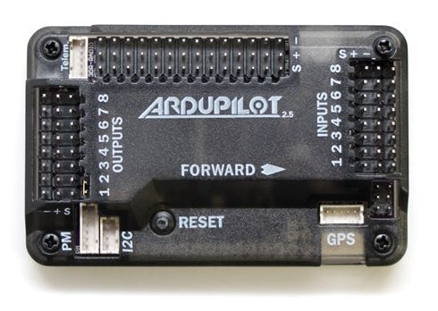
Autopilot
Autonomous Flight
Ardupilot Mega 2.5
Inherited from last year’s team ($200+ savings)
Sensors
Accelerometer, magnetometer, altitude, and GPS.
Supported by Mission Planner
Open source, GUI-based waypoint/mission plotter
Write Python scripts to reprogram waypoints in real-time (additional secondary competition objective)

Slide 17
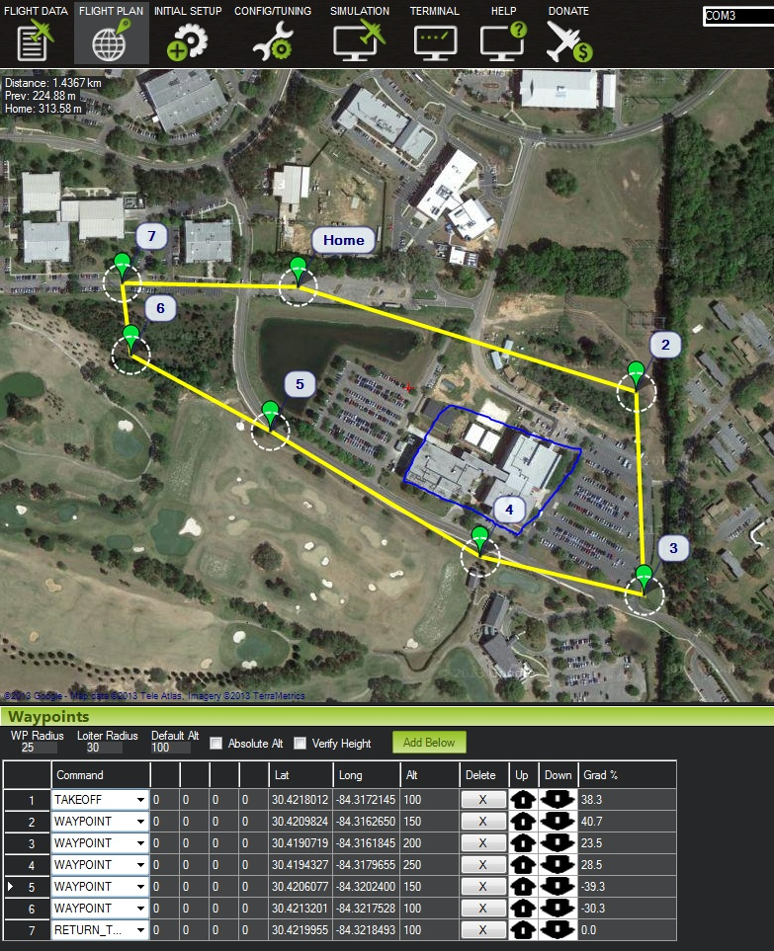
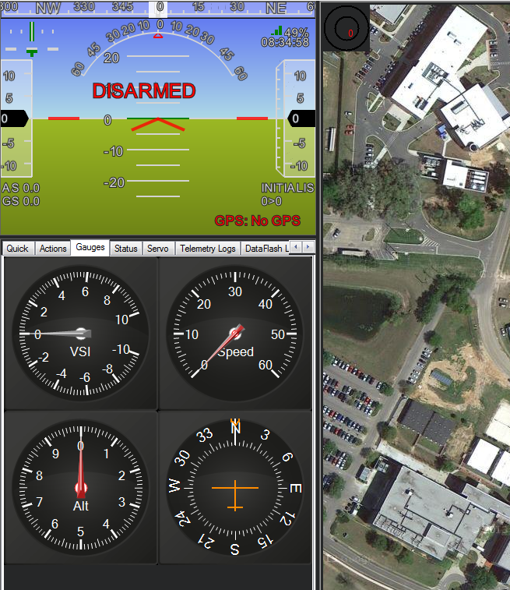

Slide 18
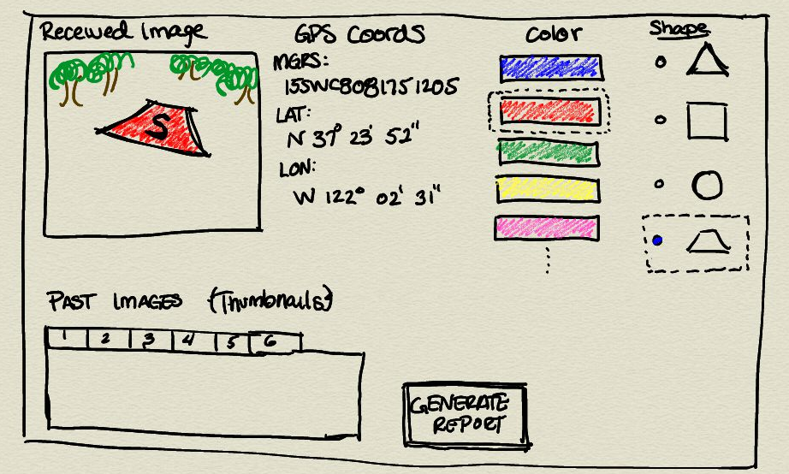
Autonomy
Autonomous Takeoff/Landing
High risk
Built-in support for autonomous takeoff/landing in Mission Planner
New plane offers better stability and control for landing
Autonomous Target Recognition
Intel’s OpenCV image processing library
Open source, highly documented, great support community
Apply filters, use algorithms to determine target characteristics
Custom GUI
Using OpenCV, create various programs compiled to one or more DLLs
Import our image processing DLLs into a custom (from scratch) GUI for identification and reporting

Slide 19
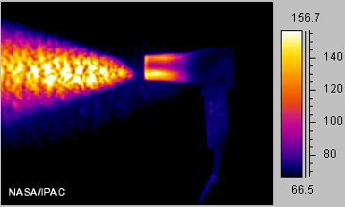
Rejected Options
Infrared Camera
High cost
Secondary objective in competition
Retractable Landing Gear
No priority in competition
No significant aerodynamic benefit
Long time to build
Risk of failure/difficult landing

Slide 20
Future Outlines
Implement glass door camera housing and test for effectiveness
Test autonomous flight
Build egg drop mechanism
Begin coding the autopilot scripts and image processing
Repair test plane and add components to new plane

Slide 21
References
(http://www.fas.org/sgp/crs/natsec/R42136.pdf)
(http://www.fas.org/sgp/crs/natsec/R42938.pdf)
http://www.auvsi-seafarer.org/documents/2014Documents/2014_AUVSI_SUAS_Rules_Rev_0.2a_DRAFT_13-0930-1.pdf
http://airfoiltools.com/airfoil/details?airfoil=spicasm-i
http://www.pprune.org/tech-log/434511-aerodynamics-flap-question.html

Slide 22
Lift Calculations
Notes:
I think having two additional slides, one with figures and one with calculations would work best for the presentation..

Slide 23
Questions?

